Slide 1



Slide 2


Slide 3
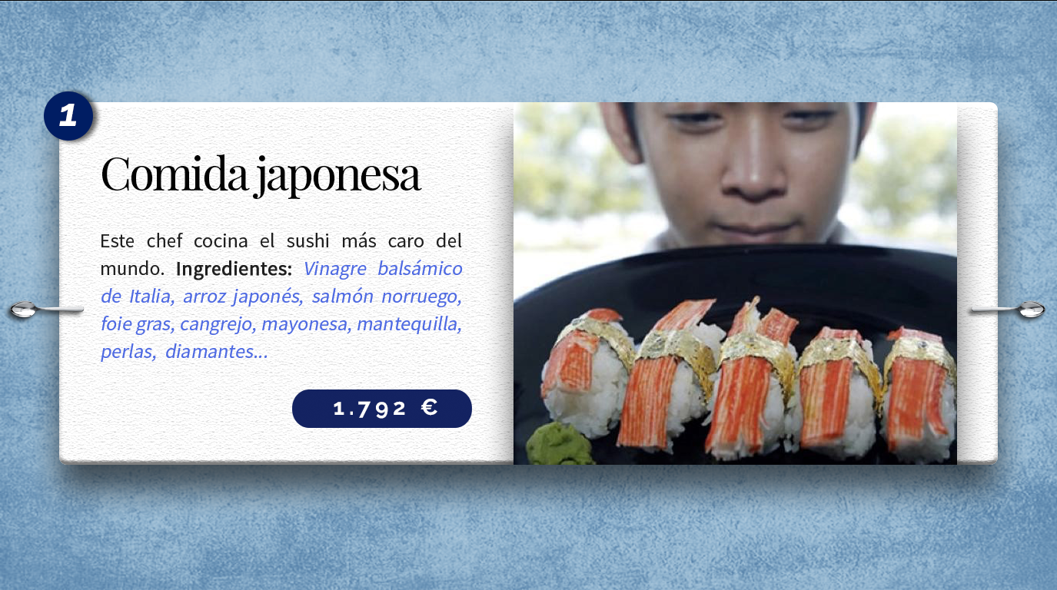
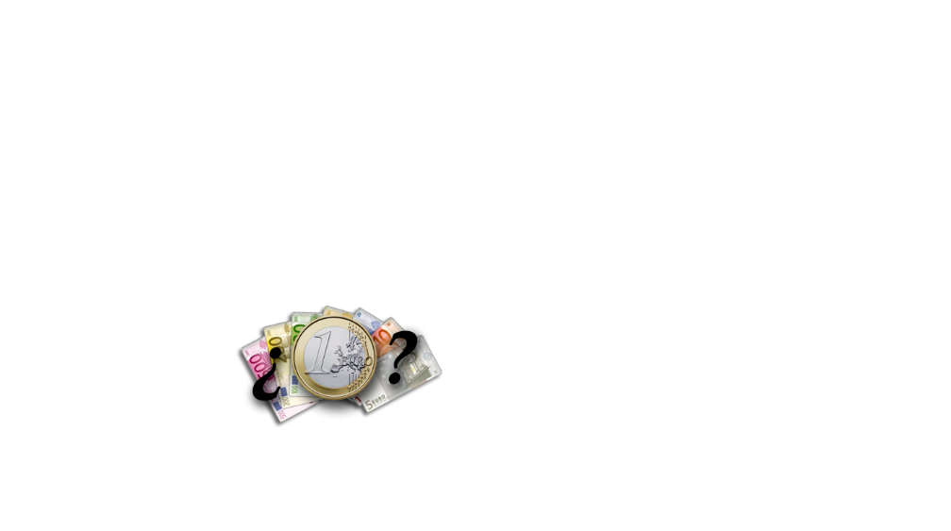

Notes:
The chef advertises this as the world’s most expensive, but the only information this lister could find on it is now 2 years old. He has likely thought up an even more expensive roll since then, but even so, this one will set you back $1,971 for 4 pieces. From his Facebook page: “12-year-old, Italian balsamic vinegar, Japanese rice, 70-year-old virgin water, Muscovado sugar, Norwegian pink salmon, pink salmon roe, cucumber, mango, foie gras, sea cucumber (smoked then pickled and steamed ’til tender sticky), genuine crabmeat, wild saffron, mayonnaise with butter, 12 local Palawan pearls and 4, 0.20-carat African diamonds of VVS clarity.” VVS is one grade worse than “flawless.” The pearls are about the size of garden peas, and can be eaten, or you can keep them for resale. What Araneta doesn’t mention is that each piece is wrapped in 24-carat gold leaf.

Slide 4
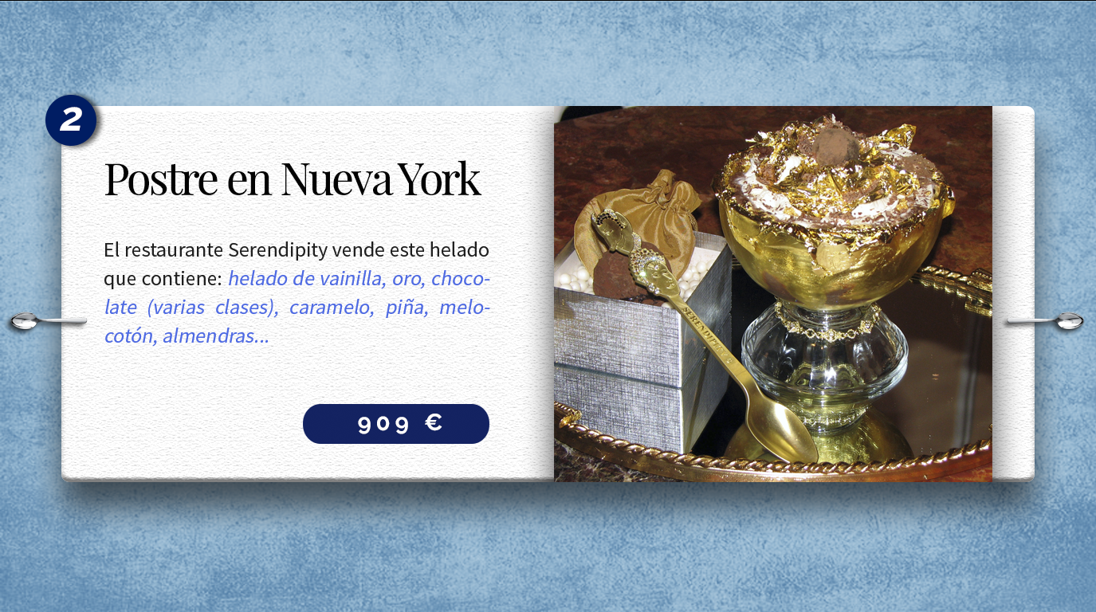
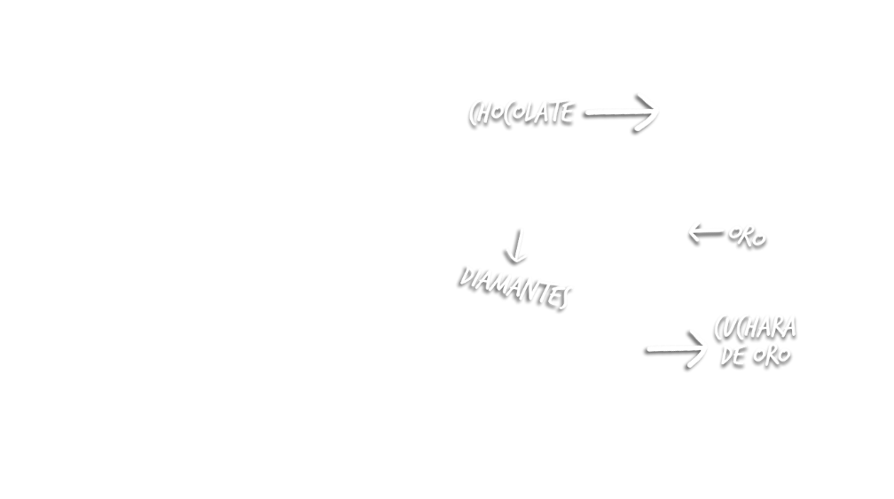
Notes:
This dessert is sold exclusively at Serendipity 3, in New York City. The restaurant is famous for selling you anything you want, even the chair you’re sitting in. Everything in the building has a little price tag on it. They will not sell ownership of the restaurant, of course. They are known for their hot dogs and iced desserts, and invented the sundae in question in 2004.You must give at least 48 hours’ notice when ordering one, so the ingredients can be acquired. Different sources report 3 and 5 scoops of vanilla ice cream. The vanilla beans are flown in from Tahiti and Madagascar, topped with 23-karat gold leaf, then drizzled with Amedei Porcelana, which touts itself as the world’s most expensive chocolate (this is most likely false – see #4). The sundae is then suffused with candied persimmons, pineapple, peach, and currants, almonds dipped in gold, marzipan cherries and small blocks of criollo chocolate, which is farmed only on the Venezuelan coast. Then a fan of gold leaf is placed on top, along with a dash of gold flake, and a few sugar-paste floral garnishes that take 18 hours to sculpt. It is served with a 24-karat gold-plated spoon inlaid with real diamonds, which you get to take home along with the gold-lined, crystal goblet – all for $1,000.In case you’re wondering: yes, you will defecate gold.

Slide 5
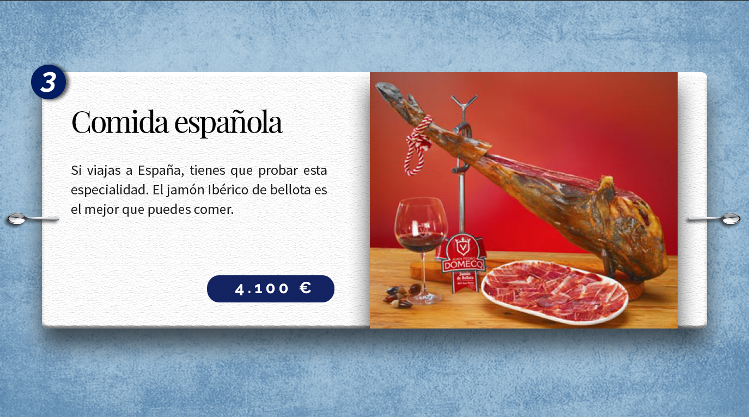

Notes:
It is Spanish for “Iberian Acorn-fed Ham.” It comes from a small area along the Spanish-Portuguese border, where the black Iberian pig is raised on a diet of nothing but acorns. This imparts a pure earthiness to the meat, not sullied by the consumption of any kind of meat, or spoiled food. All other black Iberian pigs are fed barley, corn, and oats to fatten them quickly – and their meat is also expensive – but these special pigs are given a lifetime of free range in oak groves, where they walk or run around. This exercise strengthens the meat’s earthy flavor. The hams, or hind legs, are salted for 2 weeks, then cured for 3 years. The Spanish prepare the meat by slicing it more thinly than bacon. It was not even exported to America until 2007, for no less than $96 per pound. One connoisseur described the taste as “absolutely beyond belief.”

Slide 6
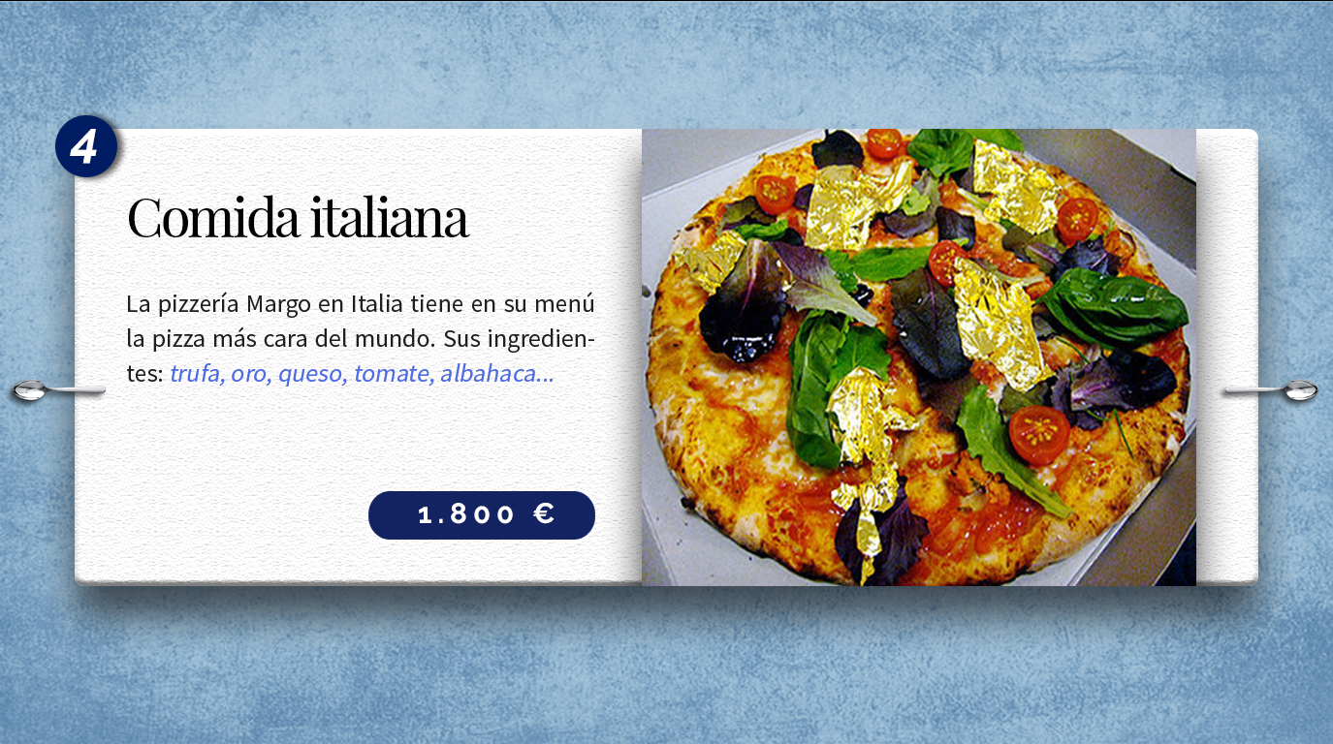

Notes:
You can eat gold. It will not nourish you, but it’s perfectly harmless, as long as you don’t choke on it. So for the wealthy, it is the ultimate expression of the word “rich.” Margo’s Pizzeria, in Malta, sells a pizza topped with white truffles and garnished with gold leaf. Truffles are the above-ground fruit of mushrooms, while the rest of the mushroom remains under the soil. White truffles, Alba madonna, are the most expensive in the world, since they are extremely rare and difficult to find, and have a complex taste described by one critic as, “like mold. Garlic. Natural gas. Cheesey. Oniony, but not oniony. Cabbagey. Earthy. Heavenly.” Margo’s slices up several to top the 14-inch pizza, with “mozzarella formaggio di bufala Campana,” that is, “mozzarella cheese made from the Campanian water buffalo.” These buffaloes roam the west coast of Italy from Rome to Campania, especially around Naples.
Margo’s then sprinkles 24-carat gold flake over the pizza. They advise the customer not to have tomatoes on the pizza, since their acid destroys the taste of the truffles. $1,800 Euros, as of 2011 (c. $2,400).

Slide 7
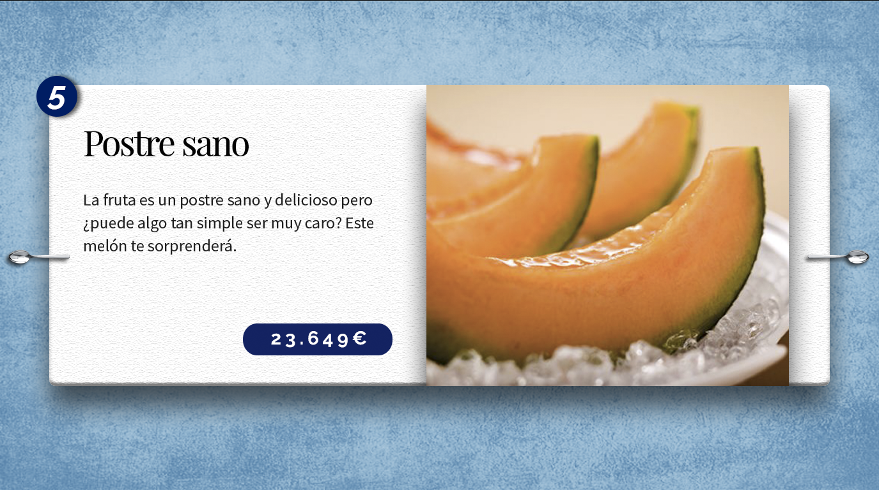

Notes:
The Yubari King melon is a cantaloupe hybrid, bred from the Earl’s Favorite, and the Burpee, or spicy cantaloupe. The hybrids are only grown in greenhouses in Yubari, on Hokkaido Island, Japan. Their taste is a perfect mix of the mellow, juicy Earl’s Favorite, spiced up with extra sweetness from the Burpee. Its taste has been described as cantaloupe on the front of the tongue, watermelon on the middle, and a long pineapple aftertaste.
You can cultivate this hybrid yourself, but you may not call it a Yubari King unless you cultivate it in Yubari. An average melon sells for $50 to $100, but the first, and perfectly spherical fruits of the year are auctioned as high as $26,000 each.
The Yubari King melon is a cantaloupe hybrid, bred from the Earl’s Favorite, and the Burpee, or spicy cantaloupe. The hybrids are only grown in greenhouses in Yubari, on Hokkaido Island, Japan. Their taste is a perfect mix of the mellow, juicy Earl’s Favorite, spiced up with extra sweetness from the Burpee. Its taste has been described as cantaloupe on the front of the tongue, watermelon on the middle, and a long pineapple aftertaste. You can cultivate this hybrid yourself, but you may not call it a Yubari King unless you cultivate it in Yubari. An average melon sells for $50 to $100, but the first, and perfectly spherical fruits of the year are auctioned as high as $26,000 each.

Slide 8
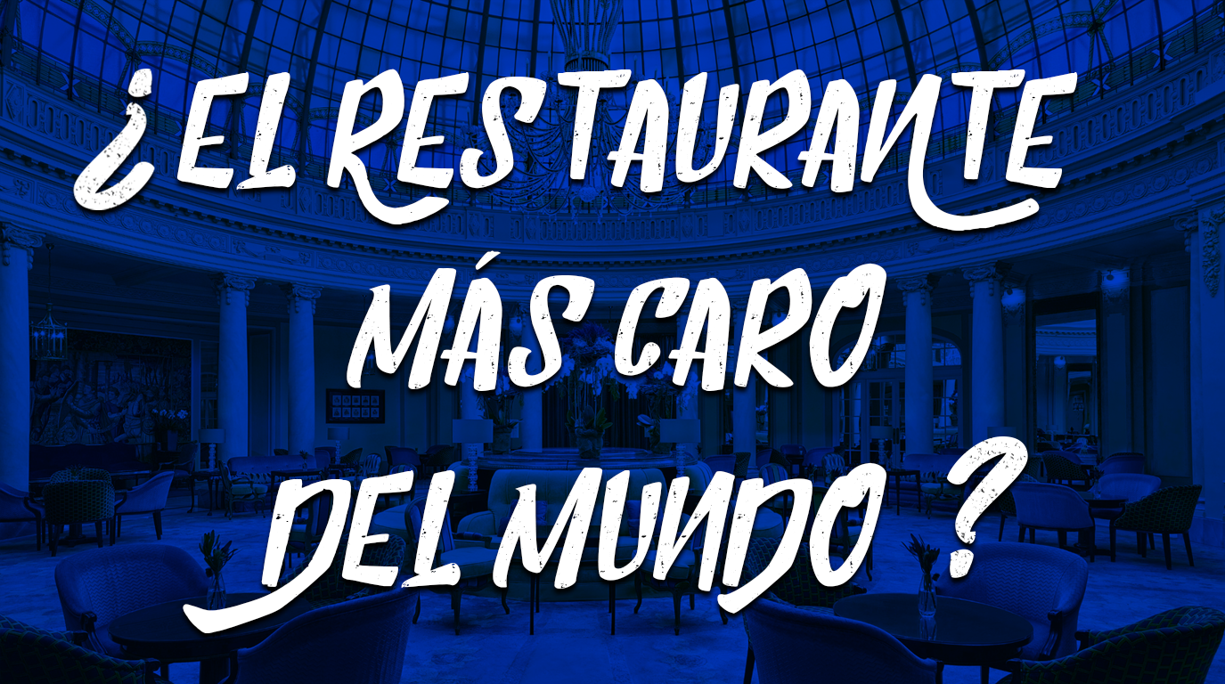
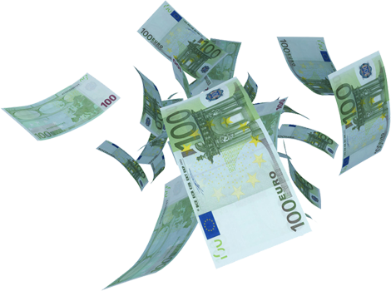

Slide 9
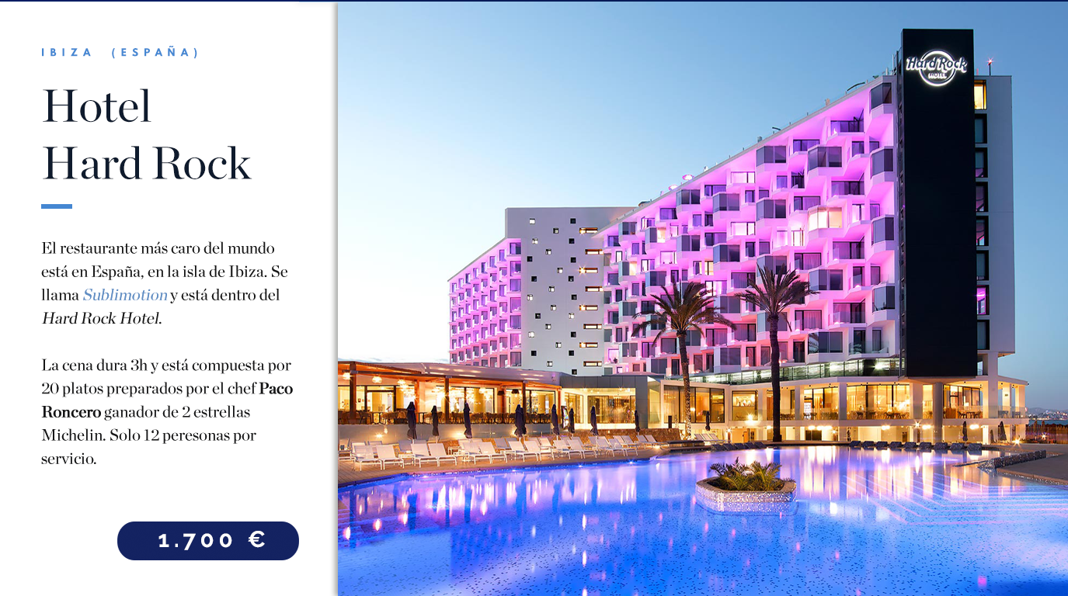
Notes:
http://www.sublimotionibiza.com/wp-content/uploads/sublimotion/docs/Sublimotion-faq-es.pdf

Slide 10


Notes:
https://www.youtube.com/watch?v=7sC8b3dM-hM
https://www.youtube.com/watch?v=E-dFKz55xlM

